Slide 1



FITNESS TRACKER
“MEASURE BETTER MOVE SMARTER.”

Slide 2

GROUP MEMBERS
Name : Bhojani Nisarg
Roll No : 132
Enroll No : 24002171210017
Batch : B4
Name : Jay Rudani
Roll No : 125
Enroll No : 24002171210157
Batch : B4
Name : Yograjsinh Vaghela
Roll No : 111
Enroll No : 24002171210198
Batch : B4

Slide 3
INTRODUCTION
Web-based AI Fitness Tracker built using Streamlit and SQLite.
Allows users to track workouts, nutrition, weight, and progress.
Provides AI-based personalized fitness advice.
Generates interactive reports and visual analytics

Slide 4
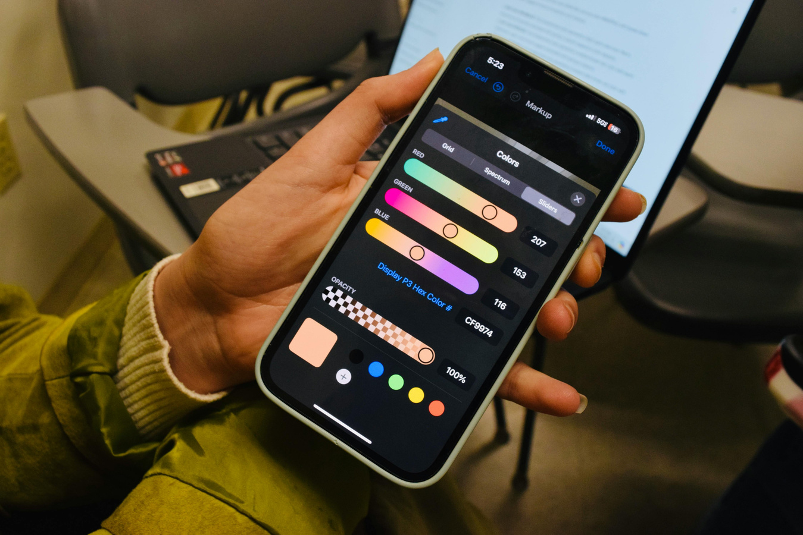
FUNCTIONALITIES
User Registration & Login
User Profile Management
BMI Calculation
Goal Selection
Personalized Diet Plans
Exercise Plans
Activity Tracking

Slide 5
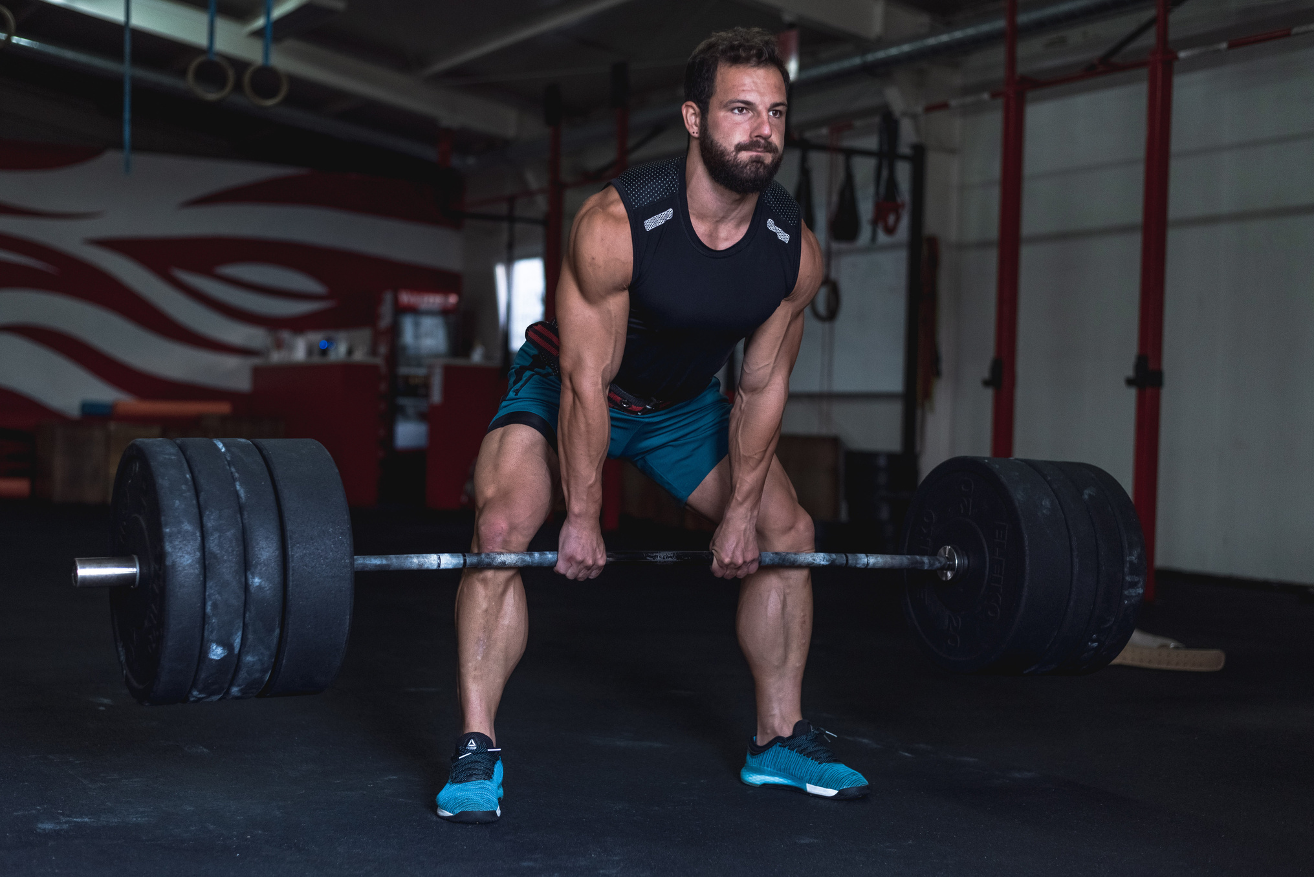
MERITS
Secure authentication with password hashing and salt
User-specific data privacy and session management
Interactive charts and progress visualization
AI-powered coaching support

Slide 6
DEMERITS
Uses SQLite, not suitable for large-scale deployment
Uses Groq AI for personalized advice with rule-based fallback
Runs locally, not cloud-hosted
Streamlit apps are not suitable for search-engine-optimized
websites.

Slide 7
FUTURE SCOPE
Growth in data science and AI applications.
Better performance optimization.
Growth in data science and AI applications.
Better performance optimization.
Integration with databases and APIs.

Slide 8
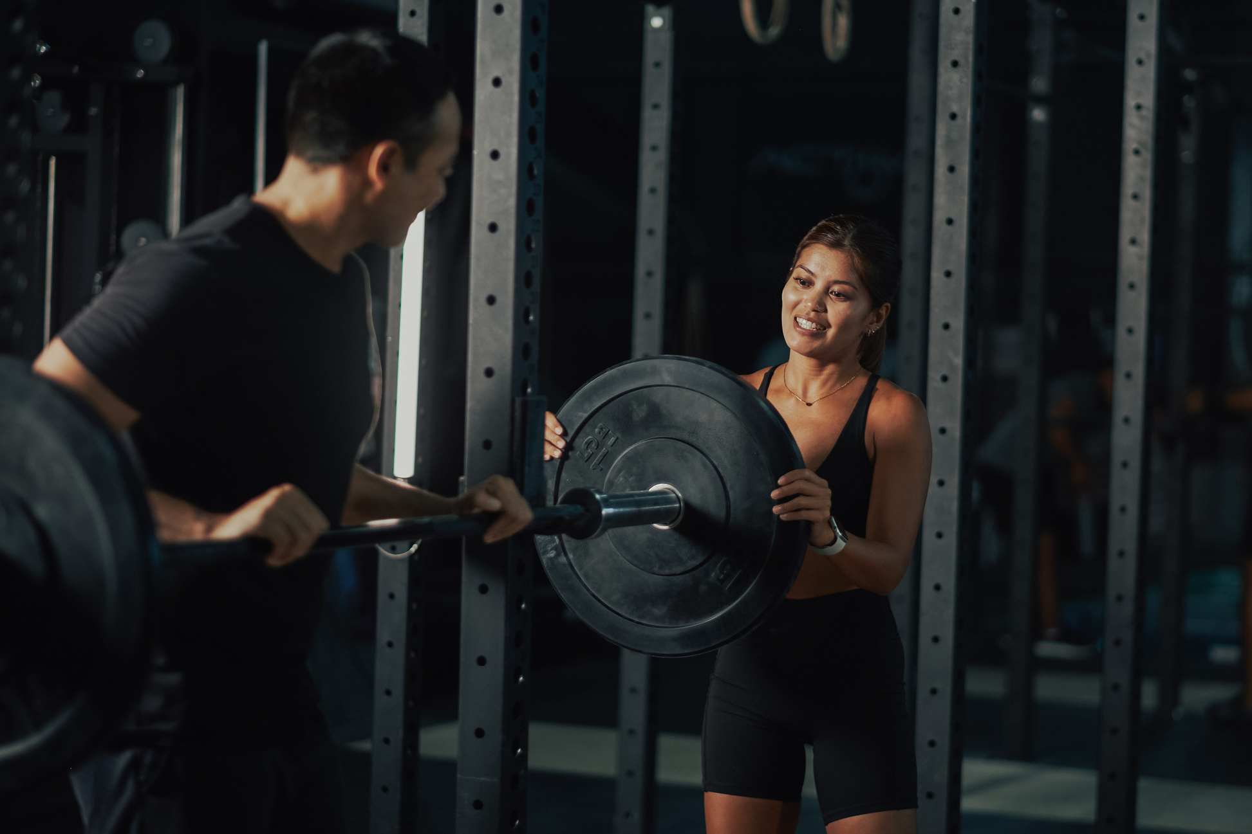
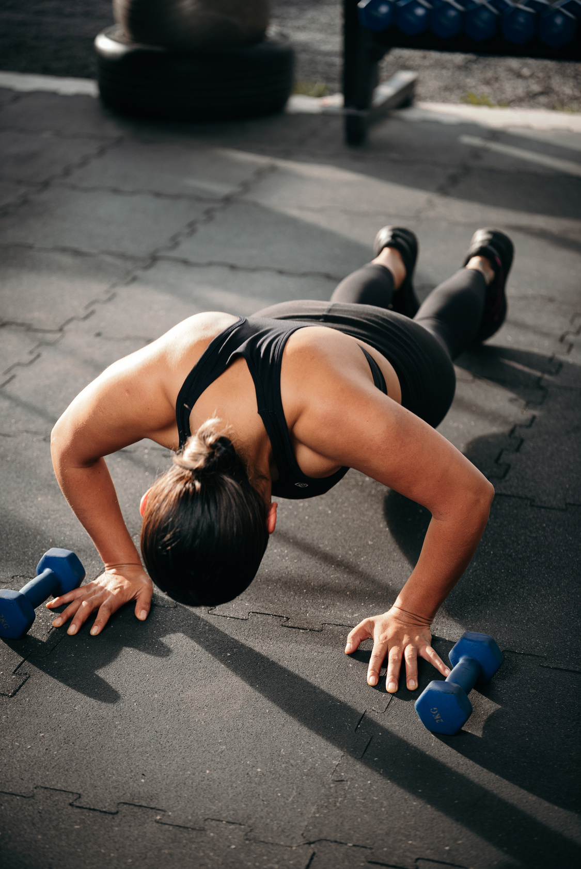
THANK YOU

